Slide 1
Financial Analysis Using Covid Data
CMPT 732 Final Project
Saurabh Singh, Viddhi Lakhwara, Aditya Panchal, Hemang Bhanushali

Slide 2
Problem Statement
COVID has had an impact on multiple sectors including financial markets
We aim to obtain a deeper understanding on how and up to what extent certain indicators were affected by COVID.
Since these indicators differ from one another, they tend to have a contrasting relation with the impact of COVID-19.
Hence, understanding these differences would allow us to gain a better insight into the financial market.

Slide 3
Technologies Used
o Apache Spark
o Apache Cassandra
o Tableau
o Machine Learning models

Slide 4
Part 1 - Create keyspace and schema for all the required tables as per the keyspace in Cassandra mentioned in the readme file on github.
Part 2 - We’ll execute the dataflix.sh script which will execute the entire project as follows:
Demo

Slide 5
Dataflix.sh
All the files like crypto.py, stocks.py, commodities.py and forex.py will perform etl and load all the respective data in cassandra tables created as there is a for loop inside the script which will run all the spark jobs and save the data for the respective datasets into the cassandra Db with dataflix as keyspace and crypto, stocks, commodities and forex tables.
The second part of the script will train the model by fetching the data from the cassandra db, after which we perform further etl and aggregate functions as per the requirements of the ml models

Slide 6
o Results after Training ML Models:
Crypto Type | Accuracy
Binance | 93.15
Bitcoin | 92.91
Dash | 92.87
Dogecoin | 92.73
Ethereum | 93.02
Litecoin | 92.96
Ripple | 92.88
Monero | 92.79
Stock Type | Accuracy
DOWJONES | 93.62
NDX COMPOSITE | 93.09
NDX | 93.21
NYSE | 92.89
RUT | 92.17
SPX | 93.43

Slide 7
Forex Type | Accuracy
Australian Dollar (AUD) | 93.12
Brazilian Real (BRL) | 92.36
Canadian Dollar (CAD) | 92.41
Swiss Franc (CHF) | 92.22
Euro (EUR) | 92.48
Pound Sterling (GBP) | 92.57
Indian Rupee (INR) | 92.29
Japanese Yen (JPY) | 93.18
Mexican Peso (MXN) | 92.20
Russian Rouble (RUB) | 92.46
Crypto Type | Accuracy
Crude Oil | 93.18
Heating Oil | 92.92
Natural Gas | 93.27
Milk | 92.86
Feeder Cattle | 92.90
Live Cattle | 92.74
Rough Rice | 93.32
Soybean Oil | 92.11
Soybeans | 92.89

Slide 8
Visualizations

Slide 9
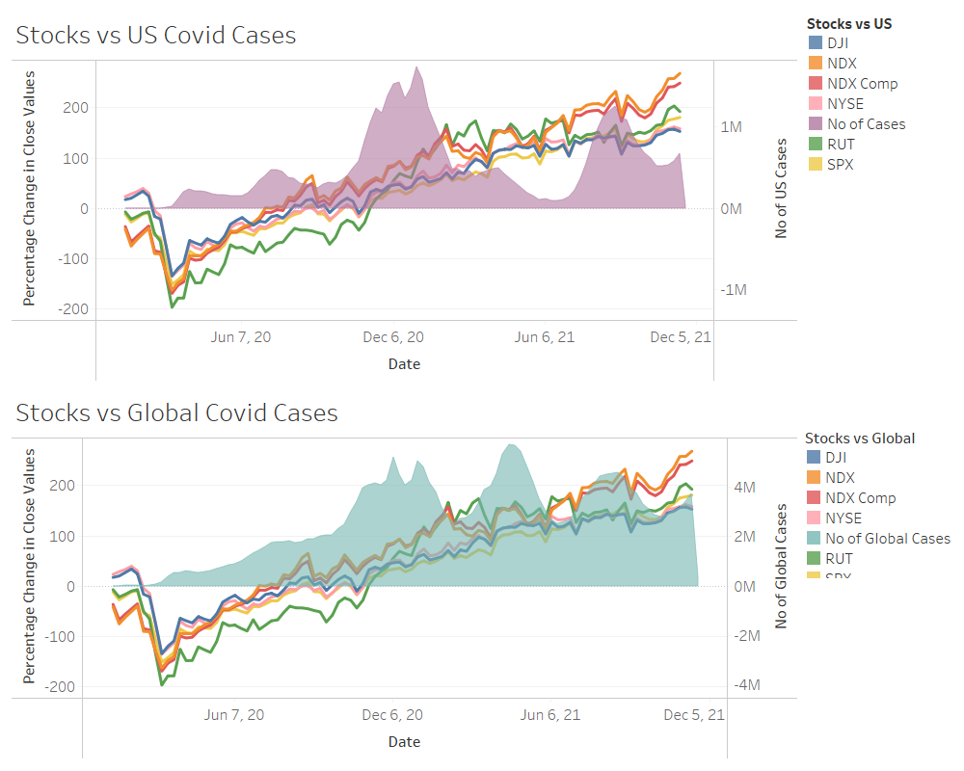
US Stock Market affected by cases Globally and United States

Slide 10
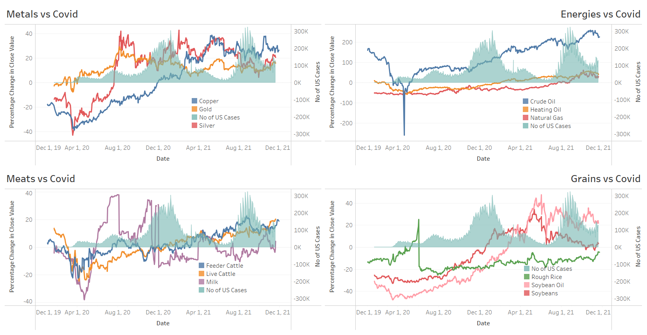
2) Various commodities affected by no of cases in United States

Slide 11
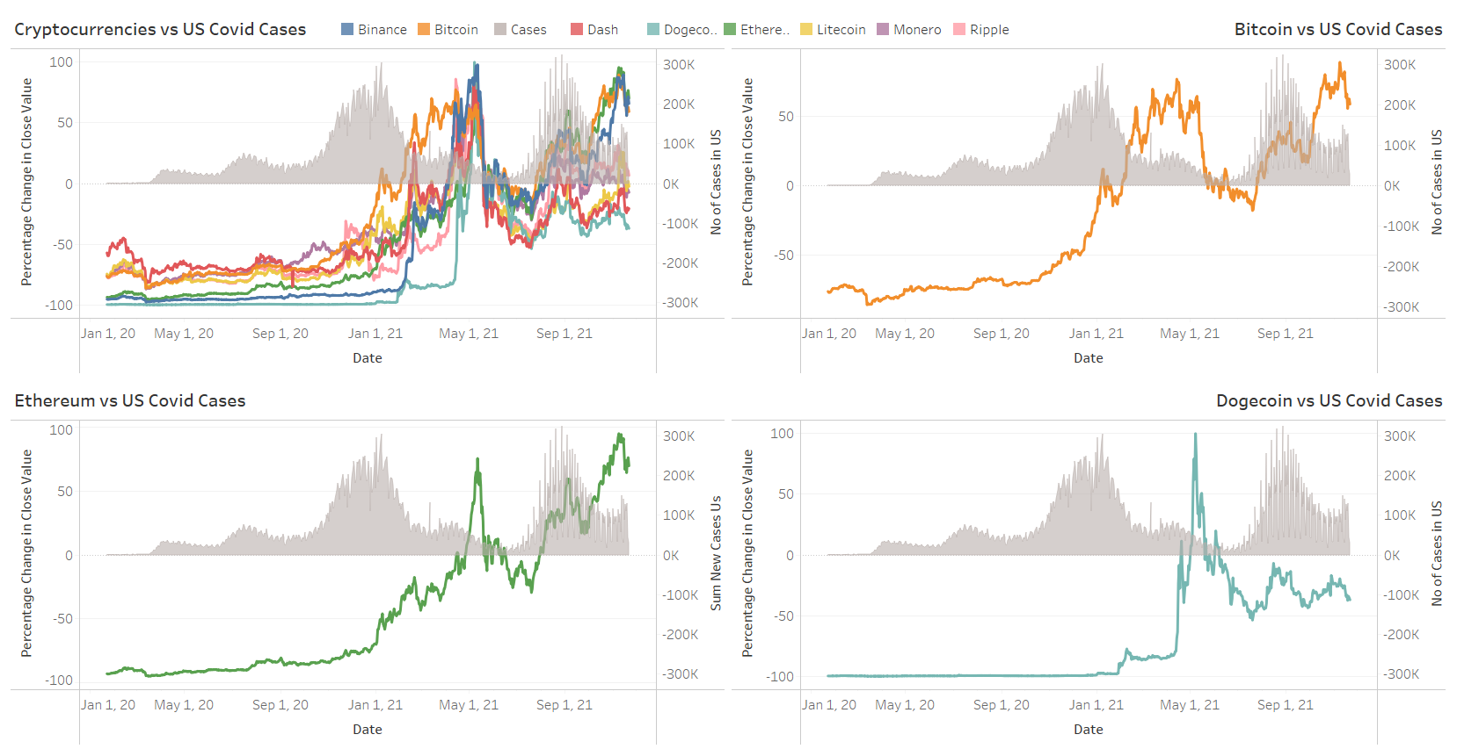
3) Various Cryptocurrencies affected by US Covid cases

Slide 12
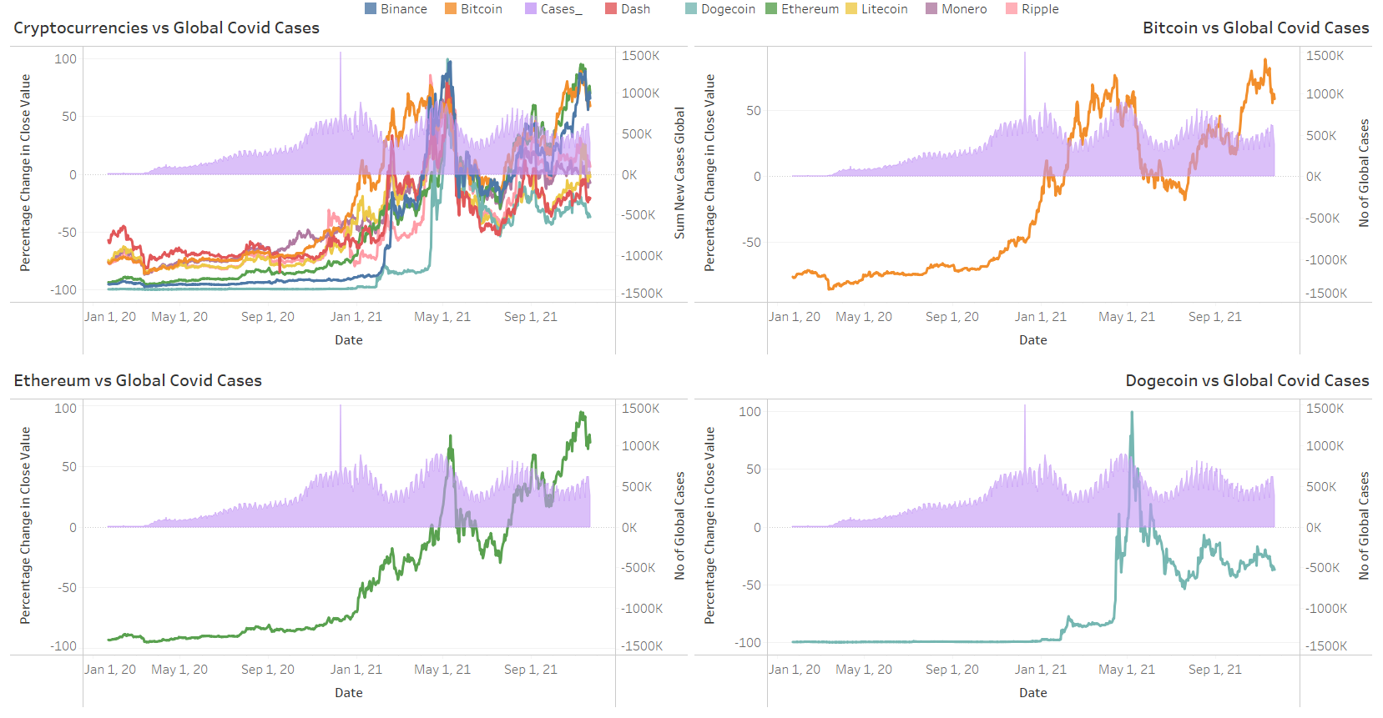
4) Various Cryptocurrencies affected by Global Covid cases

Slide 13
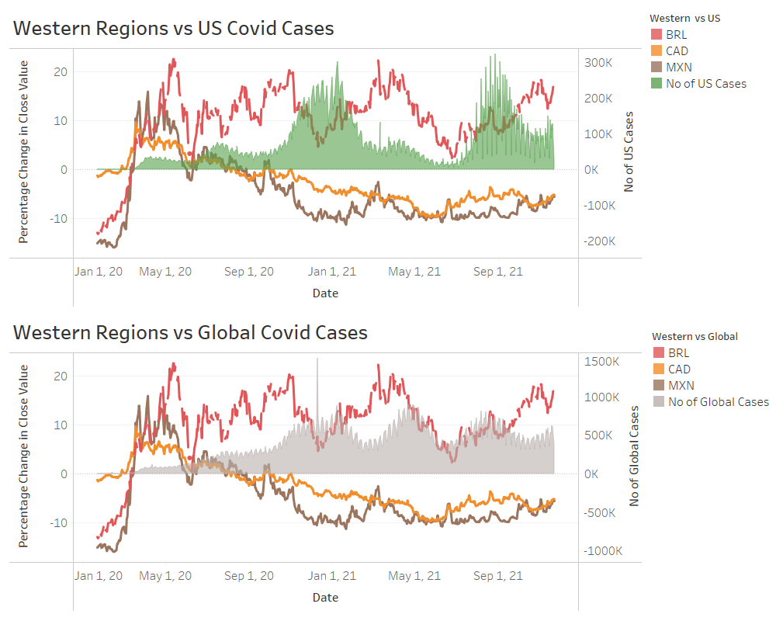
5) Western Region Currencies affected by US Covid cases and Global Covid cases

Slide 14
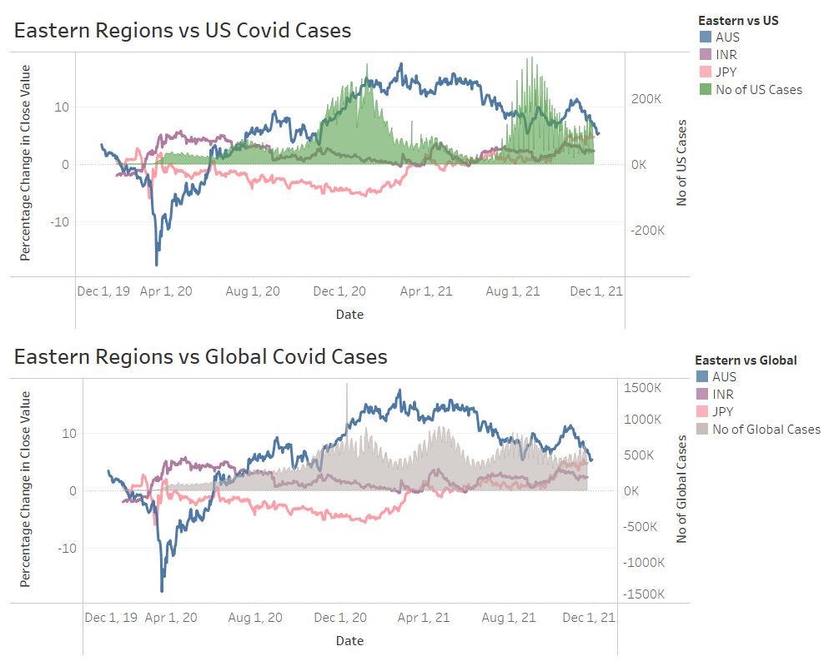
6) Eastern Region Currencies affected by US Covid cases and Global Covid cases

Slide 15
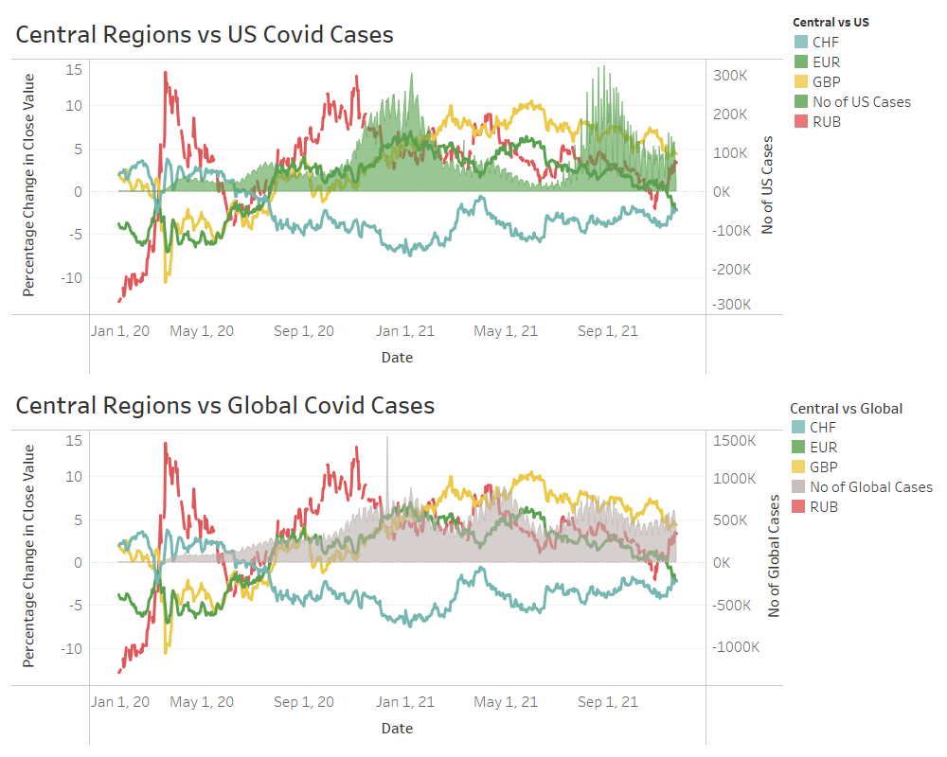
7) Central Region Currencies affected by US Covid cases and Global Covid cases

Slide 16
THANK YOU

